Slide 1
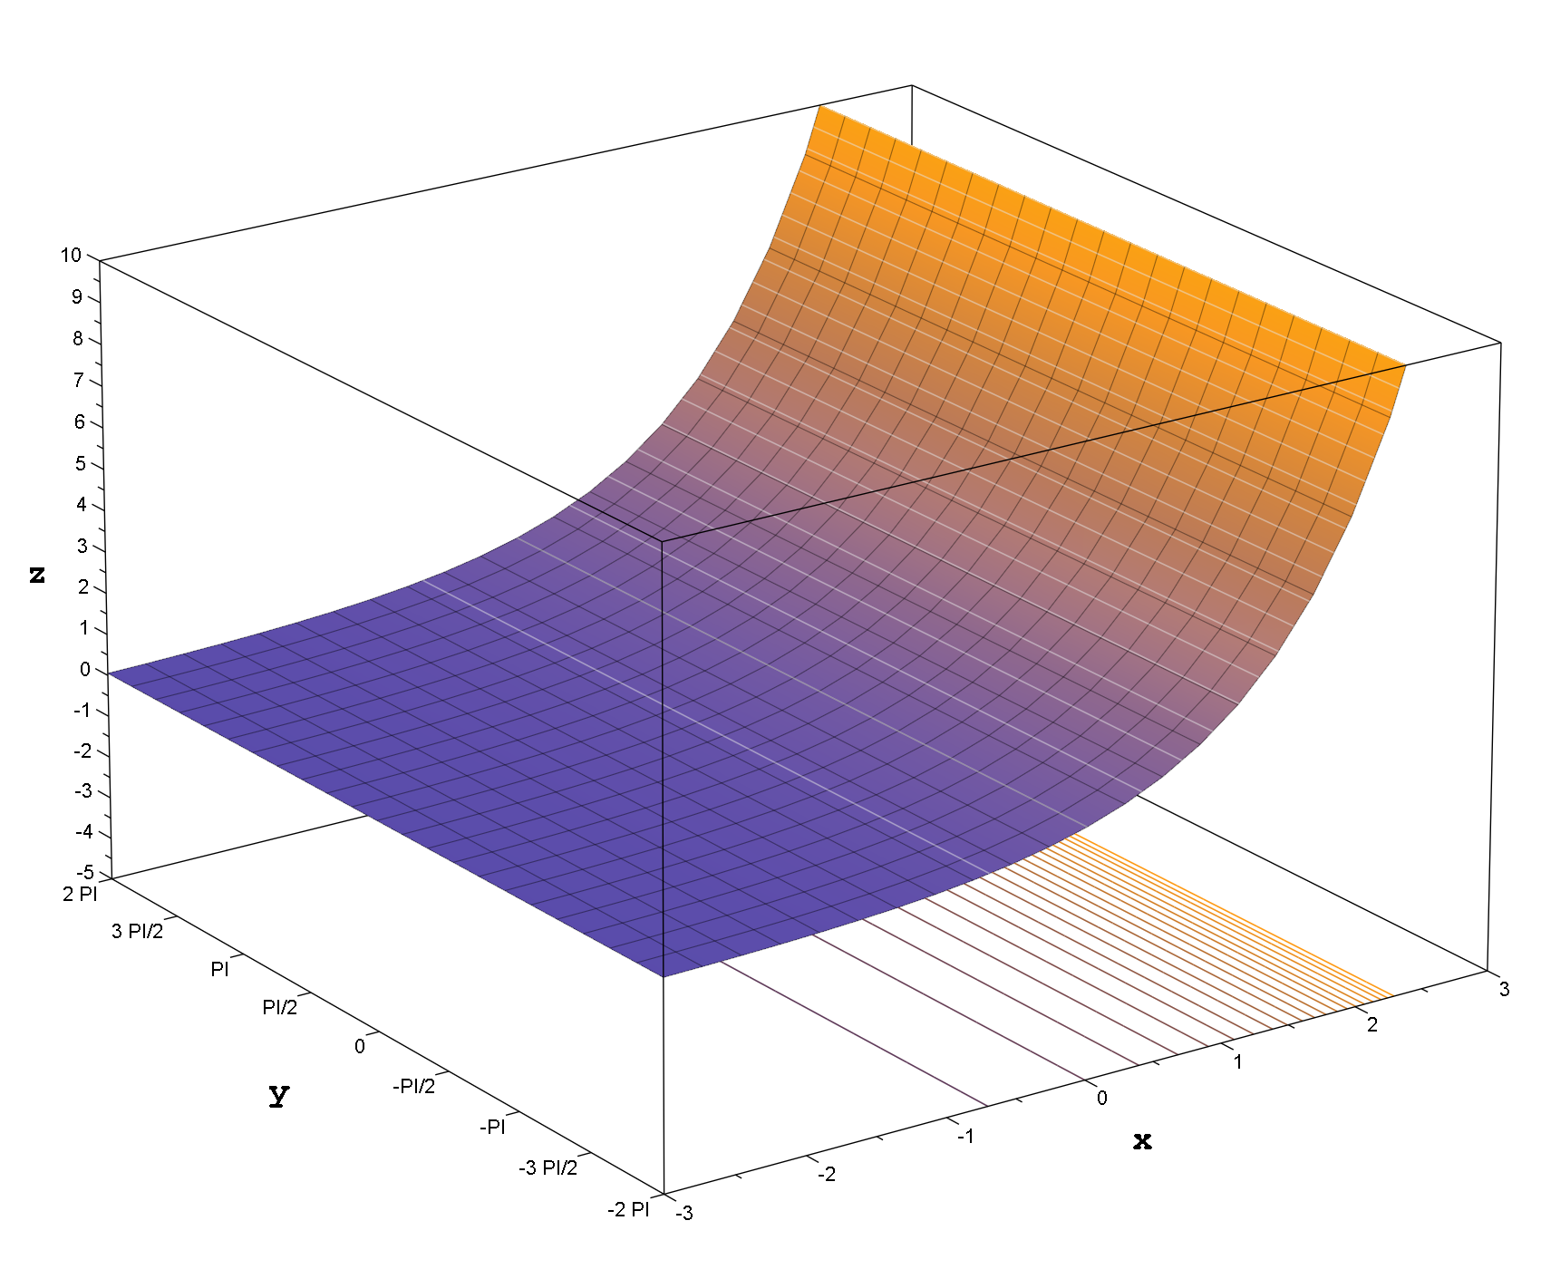
Exponential Linear Units
An Alternative Activation Function
Koh Pi Rong
C2202088

Slide 2
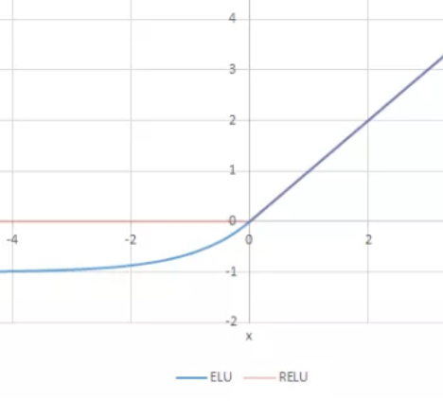
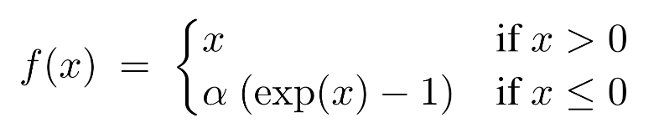
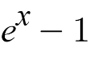
Introduction
Exponential Linear Unit (ELU) is an activation function defined as -
Compared to the commonly used Rectified Linear Unit (ReLU) activation function, ELU produces negative outputs.
ELU is claimed to decrease loss faster and produce more accurate results^{[1]}. These claims will be tested by comparing the performance of neural networks using ELU and ReLU on the below 4 network architectures -
LeNet-5 - AlexNet
VGG-16 - ResNet-50

Slide 3
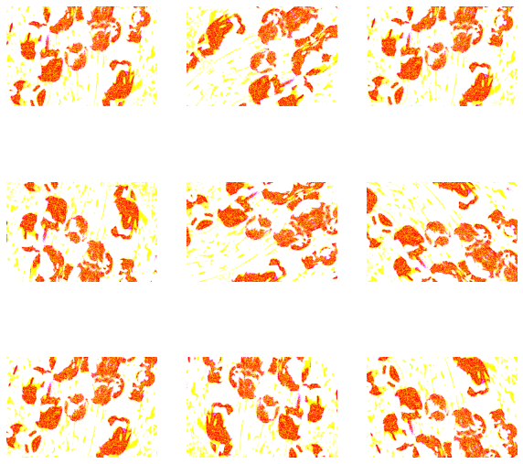
Data Pre-processing
The CIFAR-10 dataset was first obtained from Keras. The dataset consists of 60,000 32x32 RGB images^{[2]} - 50,000 are used for training and 10,000 for testing.
The training and test data was normalised to allow for easier training of the neural network.
The input image was then rotated and flipped at random - this introduces minor changes between images and prevents overfitting^{[3]}.
Challenge 1
Dataset
(60,000 Images)
Training Data
(50,000 Images)
Test Data
(10,000 Images)
Sample Of Images After Data Augmentation

Slide 4
Methods
Different Convolutional Neural Network (CNN) architectures were used to examine . They include -
LeNet-5
AlexNet
VGG - 16
ResNet-50
For equal comparison, a batch size of 64 samples and 30 epochs were used for each training.

Slide 5
LeNet-5
Input
LeNet-5 is a simple CNN developed in 1998, consisting of 7 layers^{[4]}. While the ELU activation function performs marginally slower, accuracy is slightly higher compared to ReLU.
Convolution
Pooling
Convolution
Pooling
 | LeNet-5 with ReLU | LeNet-5 with ELU
Test Accuracy | 63.98% | 65.56%
Time Elapsed | 2 min 23.19s | 2 min 23.56s
Dense
Dense
Dense
Output

Slide 6
AlexNet
Input
Convolution
AlexNet is a slightly complex CNN developed in 2012, consisting of 8 layers^{[5]}. As AlexNet was initially intended for the ImageNet dataset which contains 224x224 images, a resizing layer was added to scale CIFAR-10 images to the required size.
The ELU activation function performs marginally faster, but its accuracy is slightly higher compared to ReLU.
Pooling
Convolution
Pooling
Convolution
Convolution
Convolution
Pooling
 | AlexNet with ReLU | AlexNet with ELU
Test Accuracy | 84.50% | 83.36%
Time Elapsed | 32 min 24.64s | 32 min 15.08s
Dense
Dense
Dense
Output
*Using Google CoLab Pro

Slide 7
VGG-16
Input
Convolution
Convolution
VGG-16 (Visual Geometry Group) is a complex CNN developed in 2014, consisting of 16 layers^{[6]}. Compared to AlexNet, VGG-16 contains more convolutional layers which can extract greater details from images.
Although the ELU function takes slightly longer, the accuracy is higher.
Pooling
Convolution
Convolution
Pooling
Convolution
Convolution
Convolution
Pooling
Convolution
Pooling
Convolution
Convolution
Pooling
Convolution
 | VGG-16 with ReLU | VGG-16 with ELU
Test Accuracy | 85.24% | 86.36%
Time Elapsed | 61 min 28.50s | 62 min 50.60s
Convolution
Convolution
Pooling
Dense
Dense
Dense
Output
*Using Google CoLab Pro

Slide 8
ResNet-50
Input
Convolution
ResNet (Residual Neural Network) is a complex CNN developed in 2015^{[7]}. ResNet-50 consists of 50 layers. ResNet-50 contains shortcuts between layers, which helps to simplify the network and speed up training time.
The ELU activation function performs marginally slower, and with lower accuracy compared to ReLU.
Convolution
x3
Convolution
Convolution
x4
Convolution
Convolution
Convolution
x6
Convolution
Convolution
Convolution
 | ResNet-50 with ReLU | ResNet-50 with ELU
Test Accuracy | 82.98% | 81.76%
Time Elapsed | 36 min 43.61s | 37 min 32.61s
Convolution
x3
Convolution
Convolution
Pooling
Output
*Using Google CoLab Pro

Slide 9
The Best Model?
Input
Input
Convolution
Convolution
Convolution
Convolution
x2
Convolution
x3
Convolution
As CIFAR-10 is a relatively simple dataset, more layers bring about diminishing returns.
The best model evaluated was ResNet-18, a model with only 18 layers, which was faster and provided similar results.
Convolution
Convolution
x2
Convolution
x4
Convolution
Convolution
Convolution
Convolution
Convolution
Convolution
x6
Convolution
x2
Convolution
Convolution
Convolution
Convolution
 | ResNet-50 with ReLU | ResNet-18 with ReLU
Test Accuracy | 82.98% | 83.10%
Time Elapsed | 36 min 43.61s | 22 min 23.95s*
Convolution
Convolution
x2
Convolution
x3
Convolution
Convolution
Convolution
Pooling
Pooling
Output
Output
*As CoLab Pro was not available, the time taken was divided by the speed of the A100 GPU compared to the T4 GPU. ^{[8][9]}

Slide 10
Conclusion
The claim that the ELU activation function is faster and more accurate is only true for simpler CNNs. For more complex CNNs, ReLU is still preferred.
However, there are other ways which can improve CNNs -
Data augmentation
Tuning optimisers and learning rates
Weight decay and regulators

Slide 11
References
Slide 2 - 3
[1] Papers With Code. Exponential Linear Unit. Retrieved December 1, 2022 from https://paperswithcode.com/method/elu
[2] A. Krizhevsky. (2009). The CIFAR-10 Dataset. Retrieved December 1, 2022 from https://www.cs.toronto.edu/~kriz/cifar.html
[3] TensorFlow Core (2022, Feb 23). Data Augmentation. Retrieved December 1, 2022 from https://www.tensorflow.org/tutorials/images/data_augmentation
Slide 5 - Slide 8
[4] Y. LeCun (1998, November). Gradient-Based Learning Applied To Document Recognition. Retrieved December 1, 2022 from http://yann.lecun.com/exdb/publis/pdf/lecun-01a.pdf
[5] A. Krizhevsky (2012). ImageNet Classification with Deep Convolutional Neural Networks. Retrieved December 1, 2022 from https://proceedings.neurips.cc/paper/2012/file/c399862d3b9d6b76c8436e924a68c45b-Paper.pdf
[6] K. Simonyan (2015, April 10). Very Deep Convolutional Networks For Large-Scale Image Recognition. Retrieved December 1, 2022 from https://arxiv.org/pdf/1409.1556v6.pdf
[7] K. H. (2015, December 10). Deep Residual Learning For Image Recognition. Retrieved December 1, 2022 from https://arxiv.org/pdf/1512.03385.pdf
Slide 9
Training of the CIFAR-10 model took 81 min 27.45s on the T4 GPU. As the A100 GPU provided by Colab Pro is 1.47x faster than the V100 GPU ^{[8]}, which is in turn 2.46x faster than the T4 GPU ^{[9]} provided by Colab Free, we obtain a adjusted timing of 22 min 23.95s.
[8] T. Dettmers (2020, September 07). Which GPU(s) to Get for Deep Learning. Retrieved December 5, 2022 from https://timdettmers.com/2020/09/07/which-gpu-for-deep-learning/#Practical_Ampere_Speed_Estimates
[9] Y. Li (2021, August 08). Colab Pro vs. Free — AI Computing Performance. Retrieved December 5, 2022 from https://towardsdatascience.com/colab-pro-vs-free-ai-computing-performance-4e983d578fb2

Slide 12
Thank You

